Slide 1

Starbucks Coffee Reviews - Social Media Analytics
Muhammad Naufal Aniq BIN KHAIROL AMALI

Slide 2
Starbucks Coffee Review
This dataset is an in-depth collection of customer ratings and reviews for the well-known chain of coffee shops Starbucks. Text reviews, rating stars, and image links from various ConsumerAffairs website pages are among the data that was gathered via web scraping. It provides insightful information on consumer opinion and comments regarding Starbucks locations
https://www.kaggle.com/datasets/harshalhonde/starbucks-reviews-dataset

Slide 3

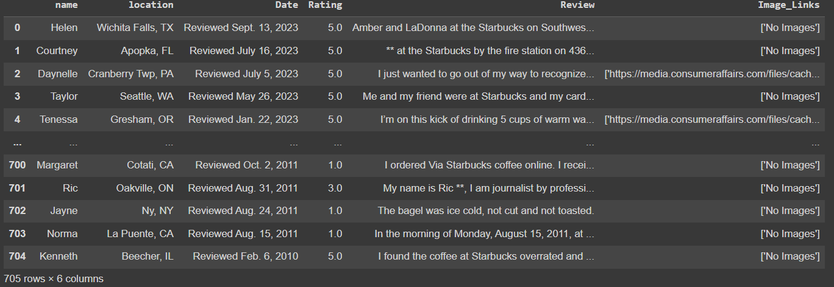

Preprocessing
First, we check the amount of rows and column that the dataset has
Output:
then, we remove all the missing and null values from the dataset

Slide 4
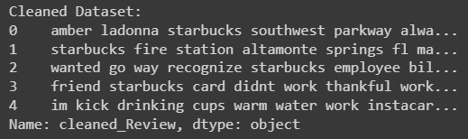
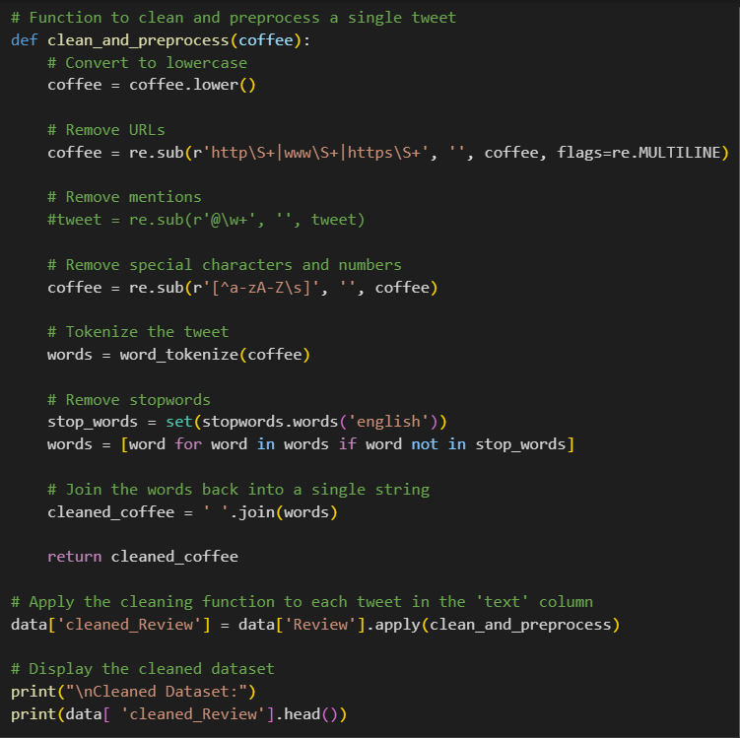
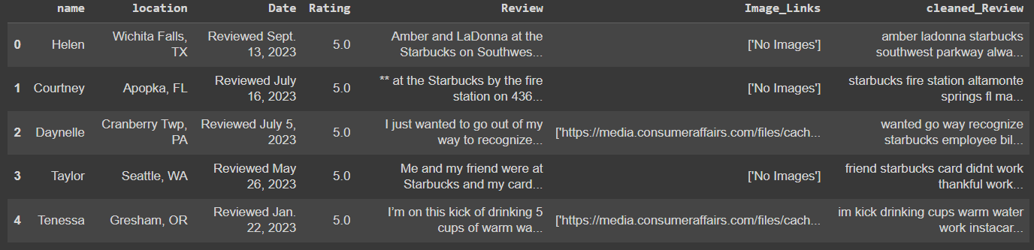
Preprocessing (cont.)
Use stopwords: remove all personal pronouns (I, you, they, our, etc.)
Use tokenizer: break up a paragraph into smaller text
Output:

Slide 5
Sentiment Analysis

Slide 6
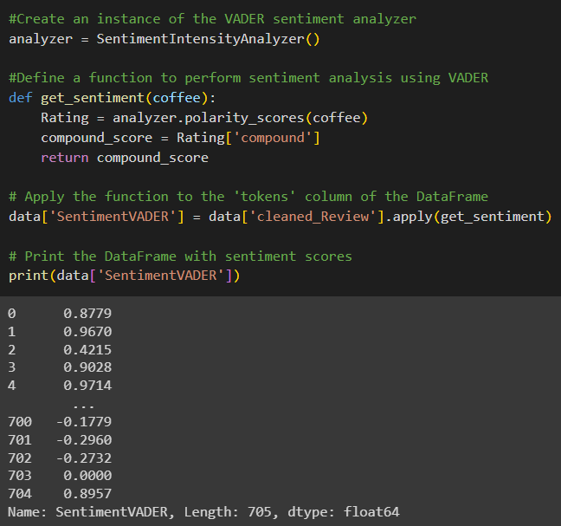
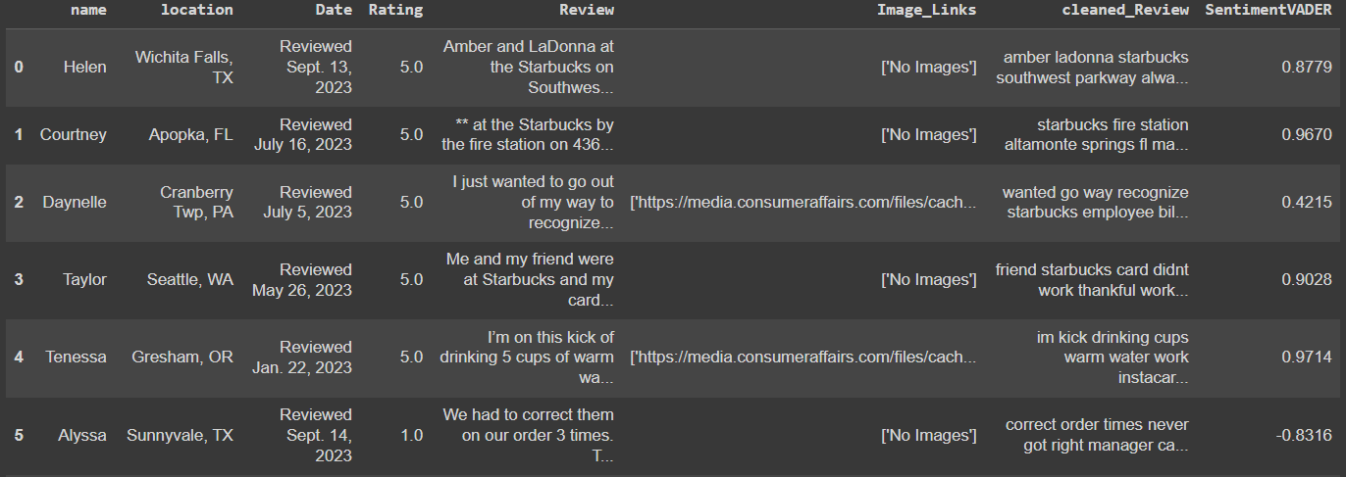
Sentiment Analysis
VADER analyzes the sentiment (positive, negative, neutral) in a piece of text.
Output: Provides a sentiment score from -1 to 1 (negative to positive)

Slide 7

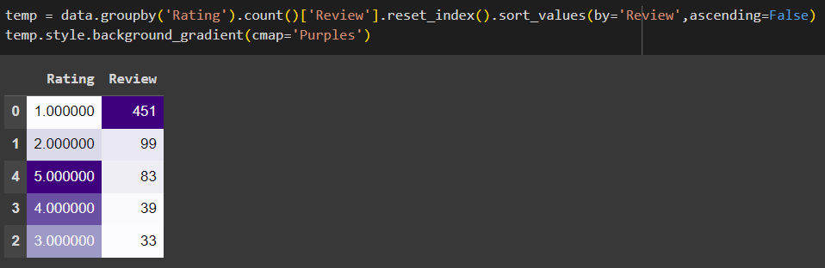
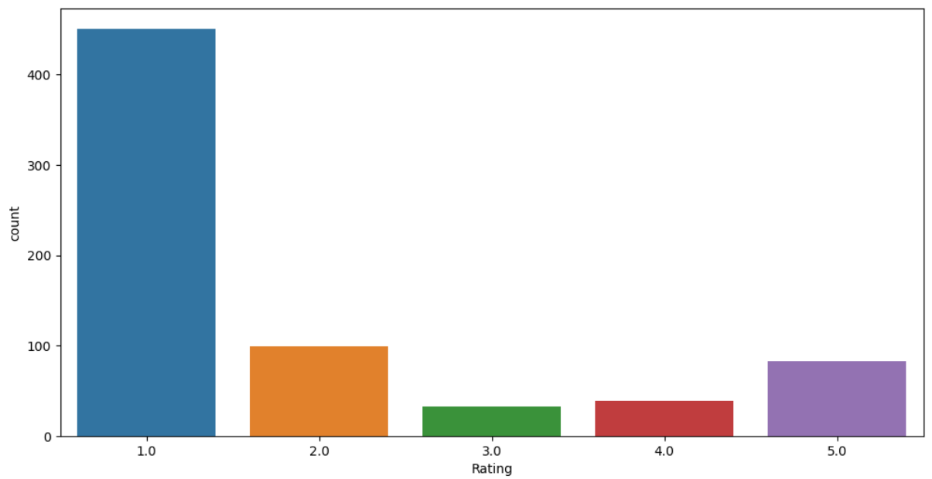
Sentiment Analysis (cont.)
We then plot it in a histogram / bar graph
It is creating a summary of the number of reviews for each rating category, sorting them, and displaying the result
Output:
The purple background gradient for visual emphasis

Slide 8
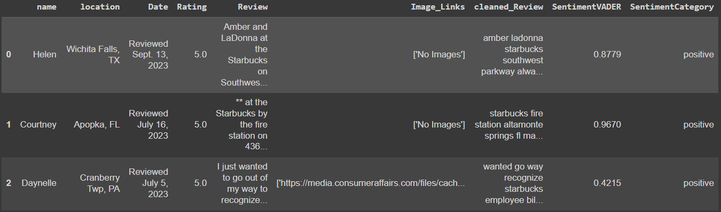
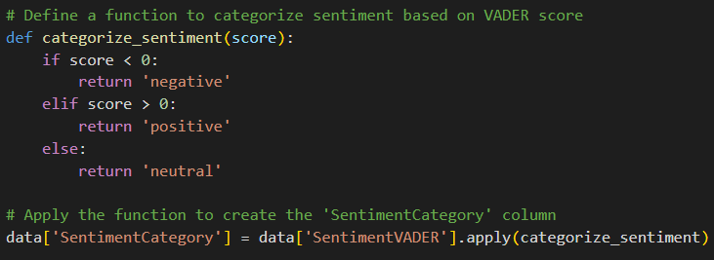
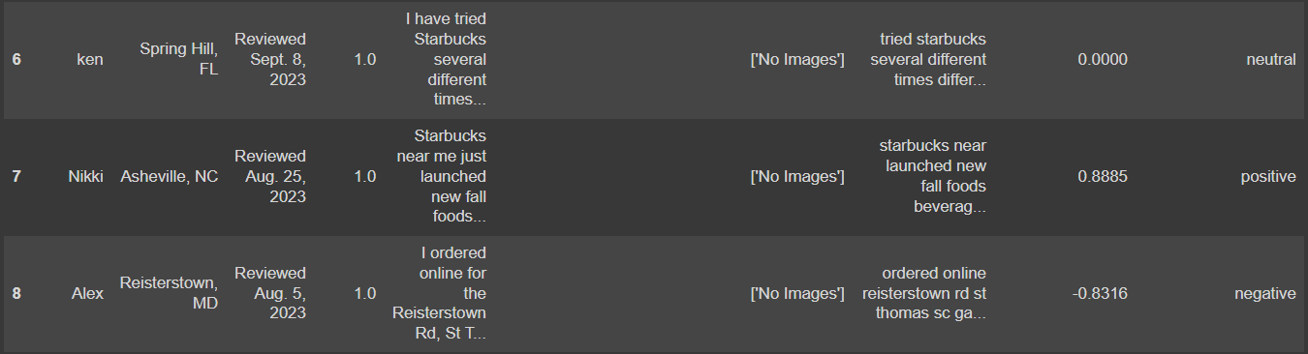
Sentiment Analysis (conc.)
Based on VADER’s score, we categorized the score into 3:
- less than 0 = negative
- more than 0 = positive
- equal to 0 = neutral
Output:

Slide 9
Topic Modeling

Slide 10
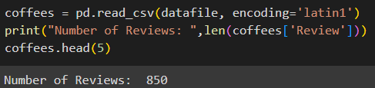
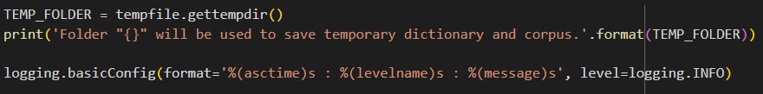
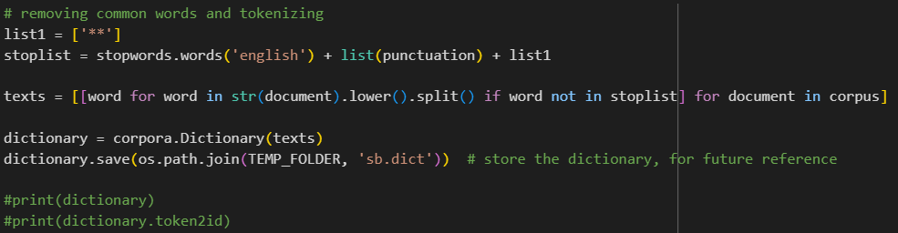
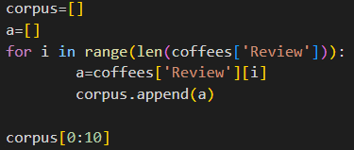
Topic Modeling
First, we check the amount of reviews the dataset has
Set up a temporary folder path and configures logging for the script.
Then, remove the no meaning, unimportant words in the Reviews and tokenize them
We extract and collect reviews into a list called 'corpus' and displays the first 10 reviews

Slide 11
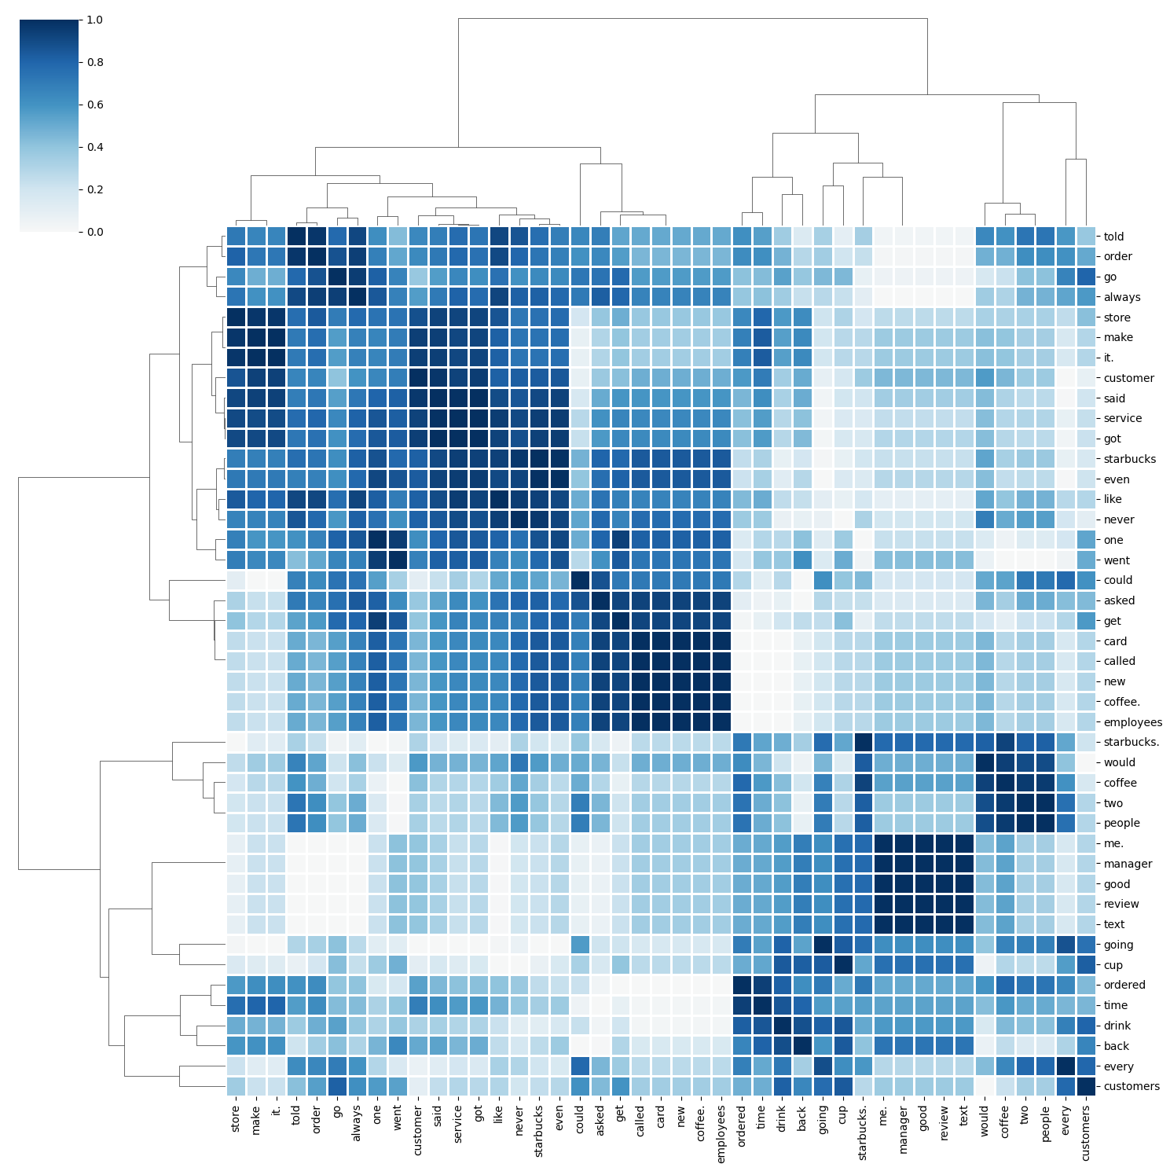
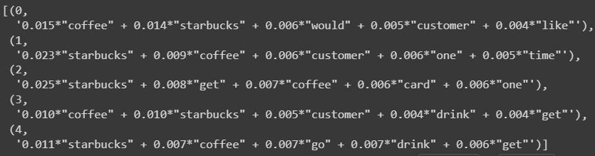
Topic Modeling (cont.)
Now, we can see all the important words that has been typed in the reviews
Then, we created a clustered heatmap to understand and see much easier

Slide 12
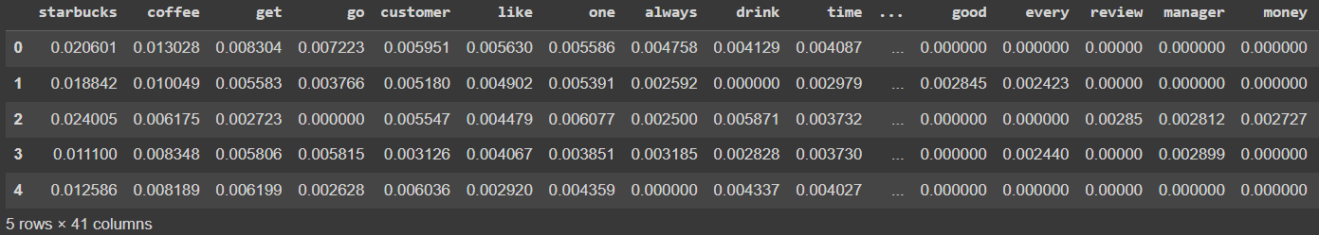
Topic Modeling (conc.)
The top topic that were talked about here are Starbucks and Coffee.
With the unique value we had, they are probably talking about the starbucks's customer card, the time they get coffee, the quantity of drinks they usually order it at the store (which is one or two) and also the customers' services that they get during their time at the store

Slide 13
Named Entity Recognition

Slide 14
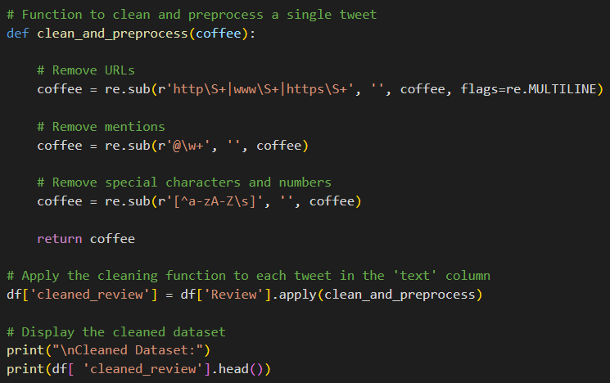
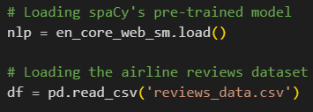
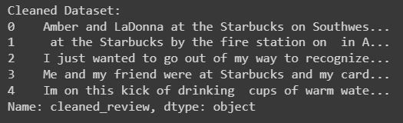
Named Entity Recognition
First, we load the NER pre-trained model and the dataset
Clean the dataset yet again before doing NER
NER identifies and classifies entities such as persons, organizations, locations, dates, and more in a given text. It automatically extracts and categorizes named entities, providing a structured understanding of the entities mentioned in the text.
Output:

Slide 15
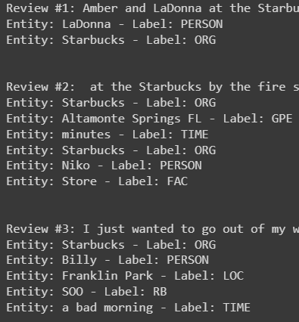
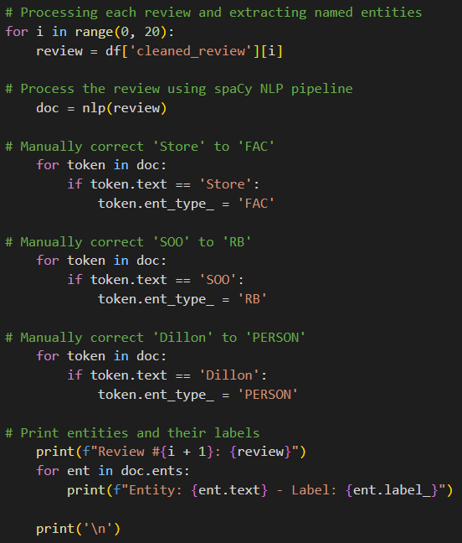
Named Entity Recognition (cont.)
the code processes a set of reviews using spaCy, manually corrects specific named entities, and prints the identified entities along with their labels in each review
Output:

Slide 16
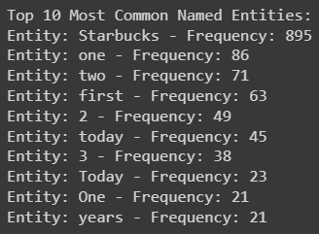
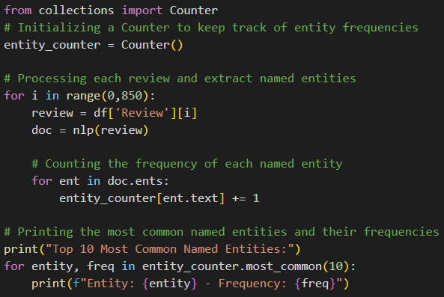
Named Entity Recognition (conc.)
the code analyzes the named entities in a set of reviews, counts their frequencies, and prints the top 10 most common named entities along with their occurrence frequencies.
Output:

Slide 17
Takeaway
The dataset review is quite small with only 800+ reviews (700 after cleaning)
Sentiment Analysis and VADER makes it easier for analyst to know which reviews are positive and negative rather than read the whole review one by one
Topic Modelling makes it easier for analyst to know what are the general people are talking about when it comes to the business or company, in this case, Starbucks and the output that I received were straight: coffees, morning, services, customer card, etc.
NER identifies and classifies entities which really helps to categorised every word said in the review

Slide 18
That’s all from me, Thank you
Muhammad Naufal Aniq BIN KHAIROL AMALI

